Slide 1
Deep Learning Introduction
Sungjoon Choi
Based on Hanjoo Yoo’s slide

Slide 2
Deep Learning
Introduction
Neural Networks for Deep Architectures
Semi-supervised Learning
Deep Learning in Computer Vision
Conclusion

Slide 3
Introduction
Section 01

Slide 4
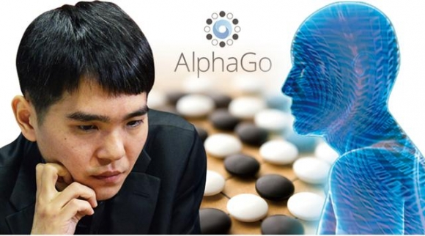
Result of Deep Learning
AlphaGo
Sedol Lee 1 : 4 Alpha Go

Slide 5
Result of Deep Learning
Speech Recognition
Word error rate improvement
Microsoft Research (MSR) developed speech recognition system with earlier work of Hinton -> 30% improvement!
24% for more than a decade
Clever new ideas typically get 2% to 5% relative improvement
Naver speech recognition (at mobile portal app)
They applied just basic deep learning method in June of this year
25% error rate improvement

Slide 6
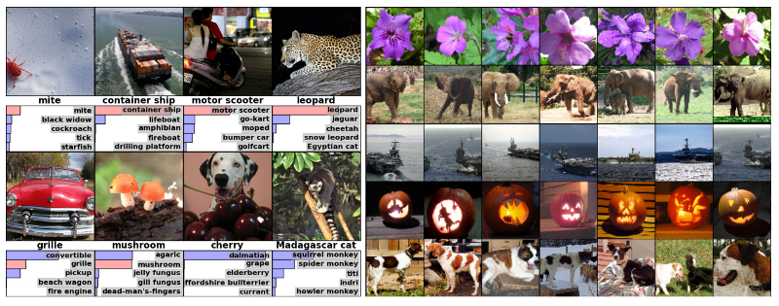
Result of Deep Learning
ImageNet Large Scale Visual Recognition Challenge
Hinton’s team scored first at last year (2012)
Seven-layer convolutional neural network with raw pixel values, utilizing two GPU for a week.
16% error rate in classifying 1.2 million images (2nd is 26%)
“It will have a big impact in the vision community” –Andrew Zisserman-

Slide 7
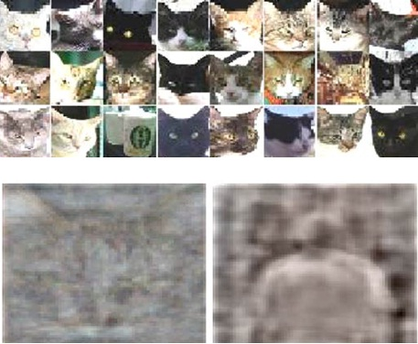
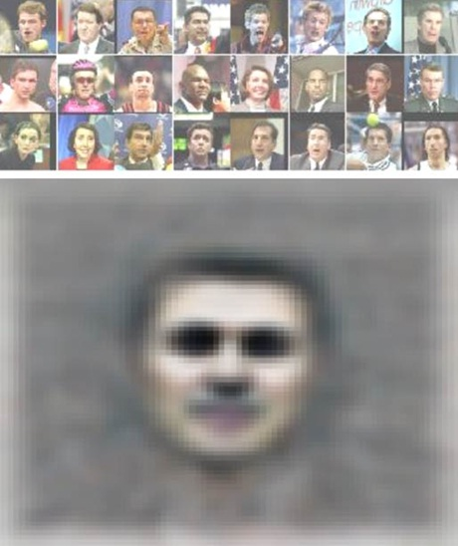
Result of Deep Learning
Face recognize
Google and Stanford Univ.
Totally unlabeled data with nine-layer neural network
3 days, 10 million images, 16,000 cores
70% improvement over previous best result

Slide 8
Before Dealing with Deep Learning…
Artificial Neural Network
“In machine learning and cognitive science, artificial neural networks (ANNs) are a family of models inspired by biological neural networks (the central nervous systems of animals, in particular the brain) and are used to estimate or approximate functions that can depend on a large number of inputs and are generally unknown.” -Wikipedia
outputs
Hidden layers
Input vector

Slide 9
What is Deep Learning?
Learning Deep Architecture for Distributed Representation
Deep Architecture
Have more or equal than one hidden layer
Neural Network
Sigmoid Belief Network
Depth
# of levels of composition of non-linear operation
The longest path from an input node to an output node
outputs
Hidden layers
Input vector

Slide 10
What is Deep Learning?
Learning Deep Architecture for Distributed Representation
Distributed vs. Localist Representation
cat
cat
dog
dog
Patterns on subset of “pool”
More biological inspired (cortex)
Neural Network
Suitable for large VC-dimension problem
Highly connected
Matter of local activation
Smoothness prior
Template matching with input -> (linear) combination of out- put value of matching
Manifold learning
Need as many examples as va- riations of interest

Slide 11
What is Deep Learning
Learning Deep Architecture for Distributed Representation
Localist Representation
Each neuron -> each thing
The simplest way to represent things with neural networks
Easy to understand.
Easy to code by hand
Often used to represent inputs to a net
Easy to learn
This is what mixture models do
Each cluster corresponds to one neuron
Easy to associate with other representations or responses.
But localist models are very inefficient whenever the data has componential structure.

Slide 12
What is Deep Learning
Learning Deep Architecture for Distributed Representation
Distributed Representation
Each neuron must represent something, so this must be a local representation
“Distributed representation” means a many-to many relationship between two types of representation (such as concepts and neurons).
Each concept is represented by many neurons
Each neuron participates in the representation of many concepts

Slide 13
Brief History of Neural Network
1940’s : Neural Network (NN)
1970’s : Back-propagation (BP) Algorithm
Compare outputs with
correct answer to get error signal
outputs
Back-propagate error signal to get derivatives for learning
Hidden layers
Input vector

Slide 14
Brief History of Neural Network
Limitations of Back-propagation method
Need labeled training data
Almost all data is unlabeled
The training time does not scale well
Computation is increase exponentially as the number of layer grows
Stuck in poor local optima
Effect of gradient method cannot propagate well through multi-layer
Overfitting

Slide 15
Why Deep Learning Again?
3 major reasons
Improvement in learning algorithm
Unsupervised pre-training techniques
Faster (x10)
Better performance
Increased computation power
CPU (x60 faster)
+ GPU (x1000 faster)
Plenty of data for training
Big data

Slide 16
Neural Networks for Deep Architectures
Section 02

Slide 17
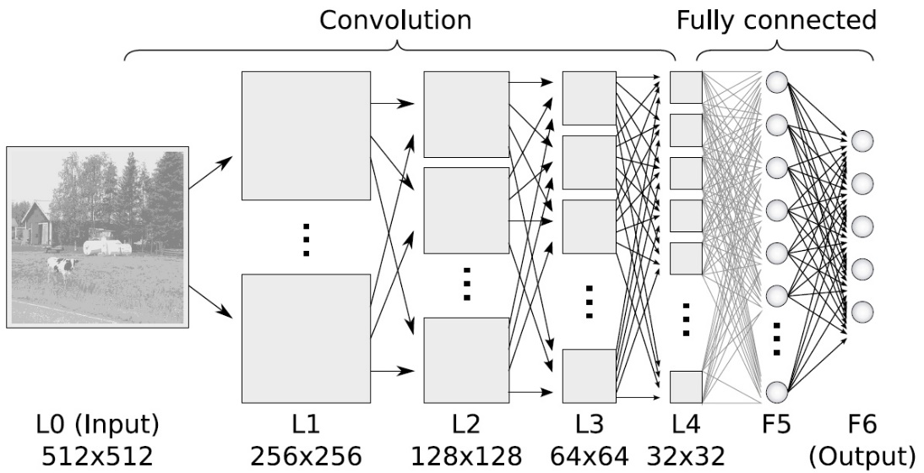
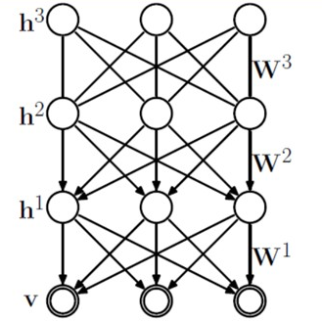
Type of architecture
Convolutional Neural Network (CNN)
Deep Belief Network (DBN)
Auto-Encoder
Convolutional Neural Network
Deep Belief Network

Slide 18
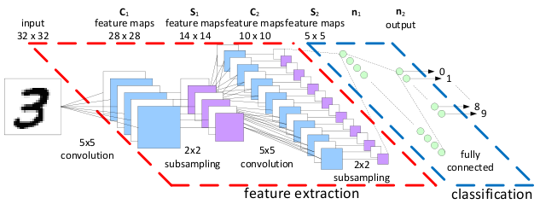
Convolutional Neural Network
Deep supervised learning
Without unsupervised pre-training, CNN can be learned with deep supervised learning
LeCun’s CNN
Convolutional layer + subsampling layer
Why it works well?
Few inputs per neuron -> gradients can propagate many layers
Hierarchical local connectivity structure -> very strong prior

Slide 19
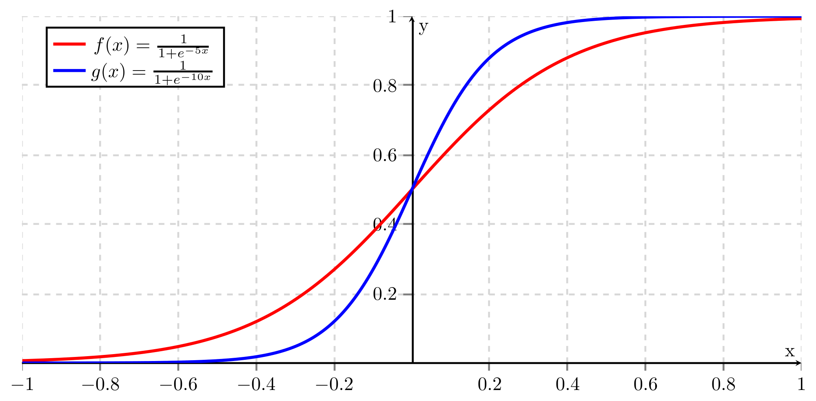
Deep Belief Network (DBN)
Deep Generative Architecture
Special case of Sigmoid belief network

Slide 20

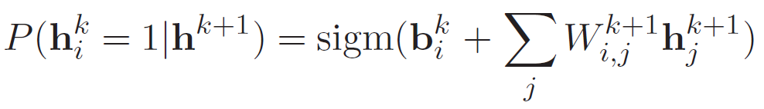

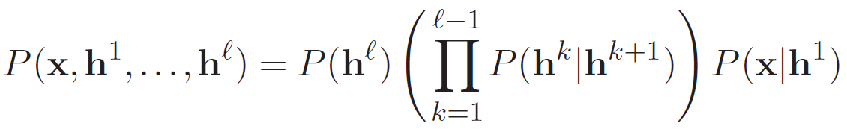

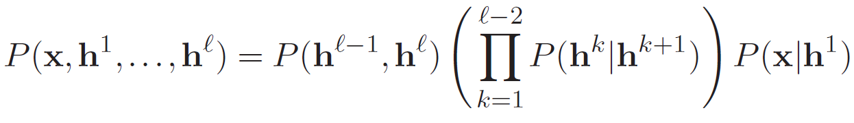




Deep Belief Network (DBN)
Deep Generative Architecture
Special case of Sigmoid belief network
Top two layer is Restricted Boltzmann Machine (RBM)
Enables greedy layer-wise training
…
■ Sigmoid belief network
$$h^{3}$$
$$h^{2}$$
…
$$h^{1}$$
…
■ Deep belief network
$$x$$
…

Slide 21




Deep Belief Network (DBN)
Boltzmann Machine
■ Boltzmann Machine
■ Restricted Boltzmann Machine
…
…
$$h$$
$$h$$
$$x$$
…
$$x$$
…
Efficient for training

Slide 22



Auto-encoder
Auto-encoder
Use encoder instead of RBM
Encode input vector x to c(x)
Objective
Deep Belief Network: maximize (configuration) probability
Auto-encoder: minimize reconstruction error (RE)
Not a generative model
$$c(x)$$
Approximates RBM training
$$x$$

Slide 23
Semi-supervised Learning
Section 03

Slide 24
Semi-supervised Learning
Overall
Training deep architecture
Pre-training -> Fine Tuning
Pre-Training
Unsupervised training
Greedy layer-wise training
From lower(input) layer to top(output) layer
Training only one layer at once by unsupervised learning
Modeling the structure of the sensory input
For finding a good initial set of weights
Fine Tuning
Better discrimination
Supervise training
Back-propagation

Slide 25




Pre-training
Training of deep belief network
Two problems
Inference: infer the states of the unobserved variables
Learning: adjust the interaction between variables to make the network more likely to generate the observed data
Why RBM?
It’s gradient is analytically tractable
Easy to train a one layer at a time
Common sigmoid belief network is hard to train a one layer at a time
Stochastic hidden cause
$$h^{3}$$
…
$$h^{2}$$
…
$$h^{1}$$
…
$$x$$
…
Visible effect

Slide 26
Pre-training
Training of deep belief network
Learn weights
Need to find the posterior distribution
Problem1: the posterior is typically complicated
Even if two hidden variables are independent, once data is observed, they are no longer independent
Problem2: The posterior depends on the prior as well as the likelihood
Need to know the weights in higher layers
All weights interact
Problme3: need to integrate over all possible configurations of the higher variables to get the prior for first hidden layer
Hard to training one layer at a time!
Hidden variables
Hidden variables
prior
Hidden variables
likelihood
weight
data

Slide 27
Pre-training
Training of deep belief network
Restricted Boltzmann Machine
Restrict the connectivity to make learning easier
Only one layer of hidden units
No connections between hidden units
Hidden units are conditionally independent given the visible states
Easy to get an unbiased sample from the posterior distribution when given a data-vector
Big advantage!
hidden
visible

Slide 28












Pre-training
Greedy layer-wise learning
Add and training (posterior) one layer at a time
Training added layer as RBM
Compute Q for sampling
Training $Q(h^{3}|h^{2})$
$$h^{3}$$
…
Training $Q(h^{2}|h^{1})$
$$h^{2}$$
…
$$h^{2}$$
…
Training $Q(h^{1}|x)$
$$h^{1}$$
…
$$h^{1}$$
…
$$h^{1}$$
…
$$x$$
…
$$x$$
…
$$x$$
…
sampling
sampling

Slide 29

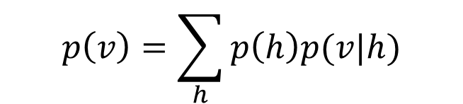


Pre-training
Why Greedy Layer-wise training works well?
hidden
$$p(h)$$
$$p(v|h)$$
visible
$$p(v)$$
$$p\left(v\right)=\sum_{h}{p\left(h\right)p(v|h)}$$
Leave p(v|h) alone and improve p(h), p(v) will be improved

Slide 30
Fine tuning
Pre-training
Making a good feature extractor
Learning distributed internal representations in the hidden layers
Generalization
Back-propagation
Using the result of pre-training as an initial set of weights
Correct labeling of training data
Weakly affects lower layer
Optimization
Alternative algorithms
“weak-sleep” algorithm

Slide 31
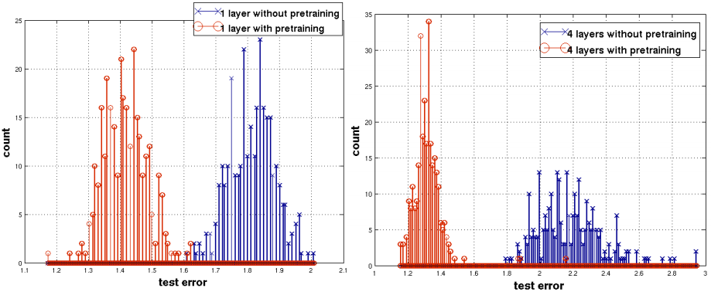
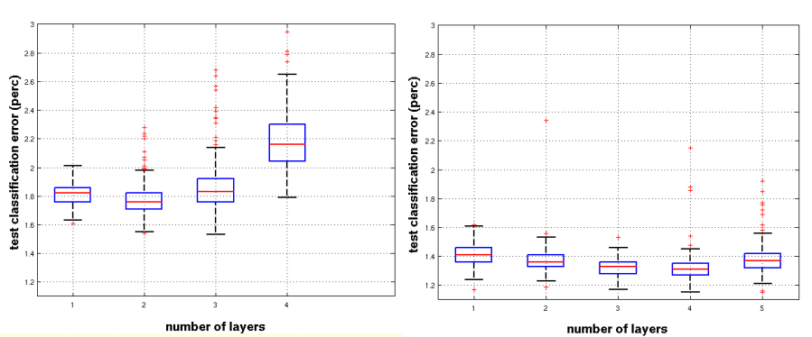
Result
Effect of unsupervised pre-training

Slide 32
Deep Learning in Computer Vision
Section 04

Slide 33
Deep Learning In Computer Vision
Data structure
Channel
Vector
Matrix
Tensor

Slide 34
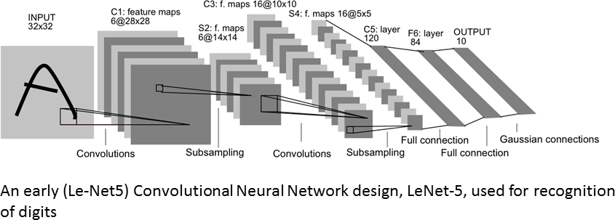
Deep Learning In Computer Vision
CNN feature
Pre-trained Convolutional Neural Network

Slide 35
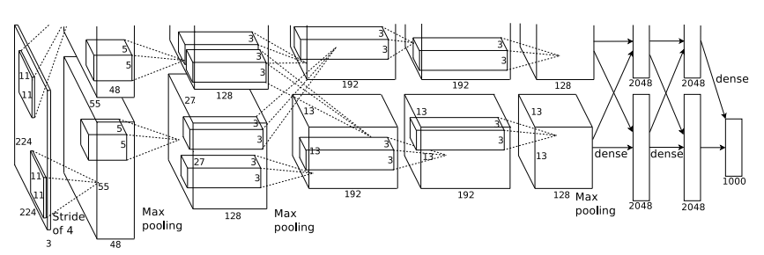
Deep Learning In Computer Vision
CNN feature
AlexNet

Slide 36
Deep Learning In Computer Vision
CNN feature
AlexNet
=

Slide 37
Deep Learning In Computer Vision
CNN feature
AlexNet
stride

Slide 38
Deep Learning In Computer Vision
CNN feature
AlexNet
=
Take only the maximum
cf) average pooling

Slide 39


Deep Learning In Computer Vision
CNN feature
AlexNet
Softmax
output
$$σ{(Z)}_{i}=\frac{e^{z_{i}}}{\sum_{k}{e^{z_{k}}}}$$
$$Z=\left(\begin{matrix}z_{1} & … & z_{n}\end{matrix}\right)$$

Slide 40
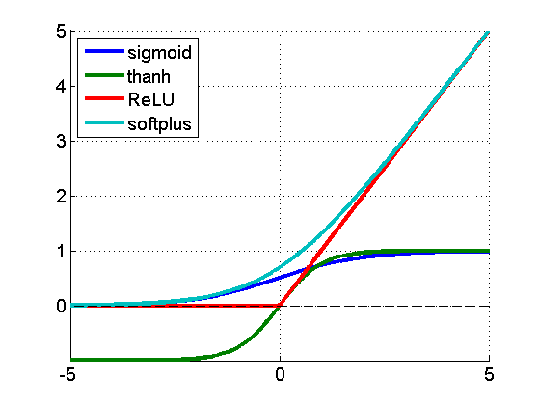
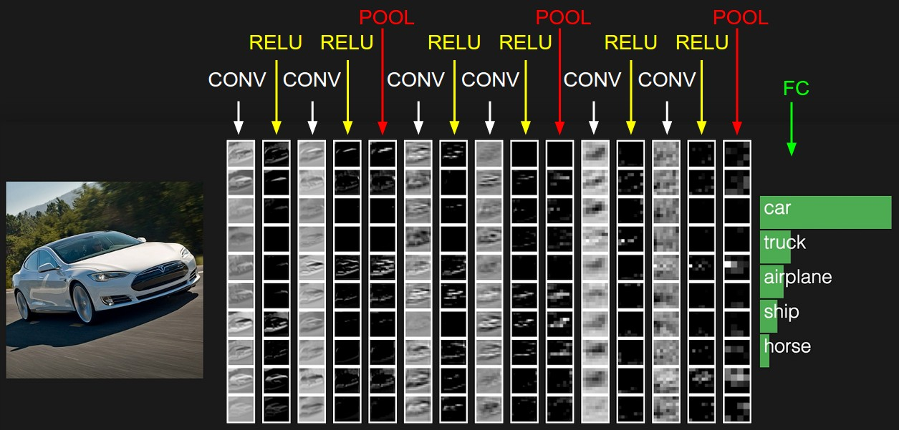

Deep Learning In Computer Vision
CNN feature
ReLU = Rectified Linear Unit
$$f(x)=max⁡(0,x)$$

Slide 41
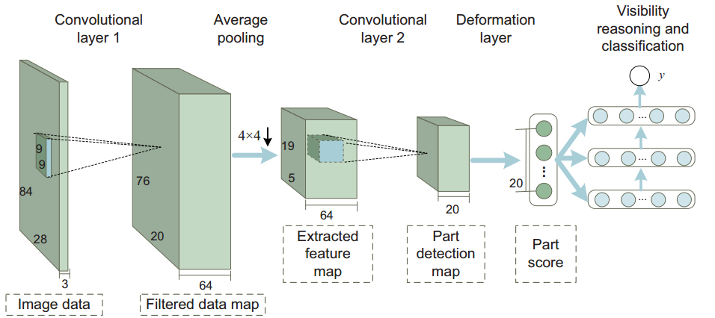
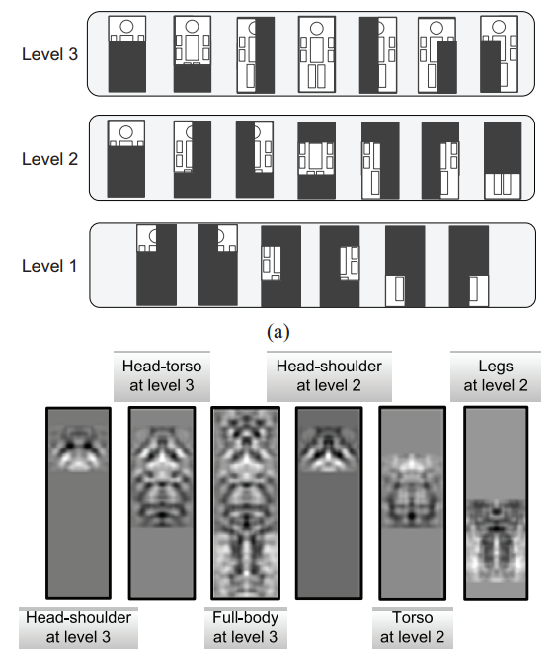
Deep Learning In Computer Vision
Pedestrian detection

Slide 42
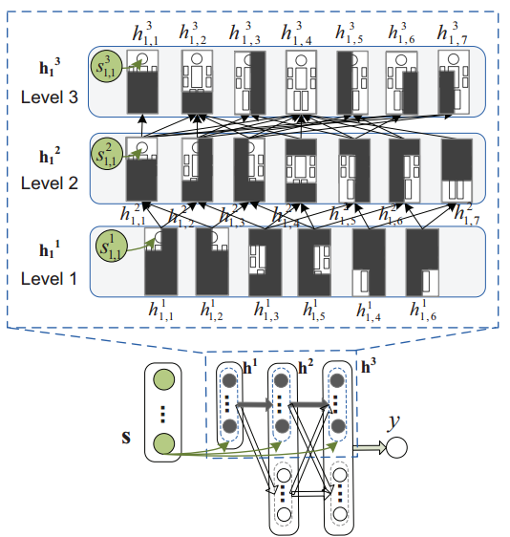
Deep Learning In Computer Vision
Pedestrian detection

Slide 43
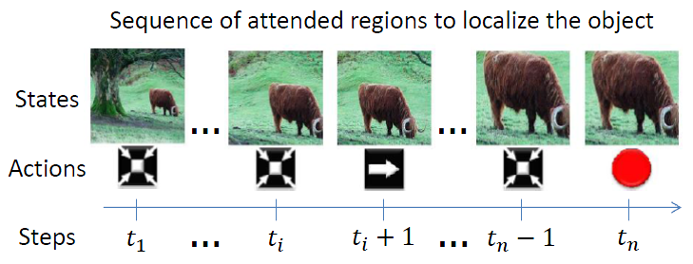
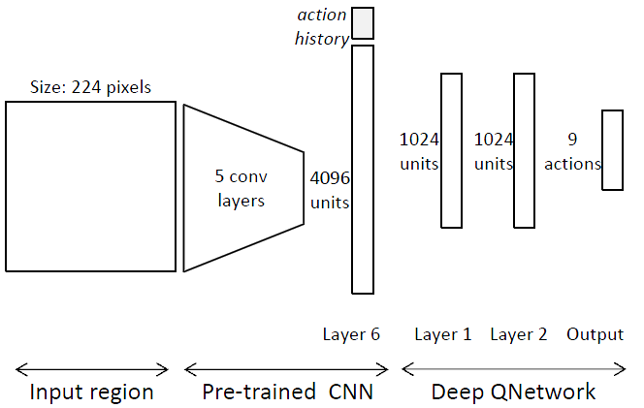
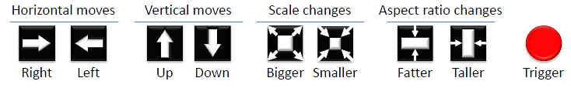
Deep Learning In Computer Vision
Object Localization

Slide 44
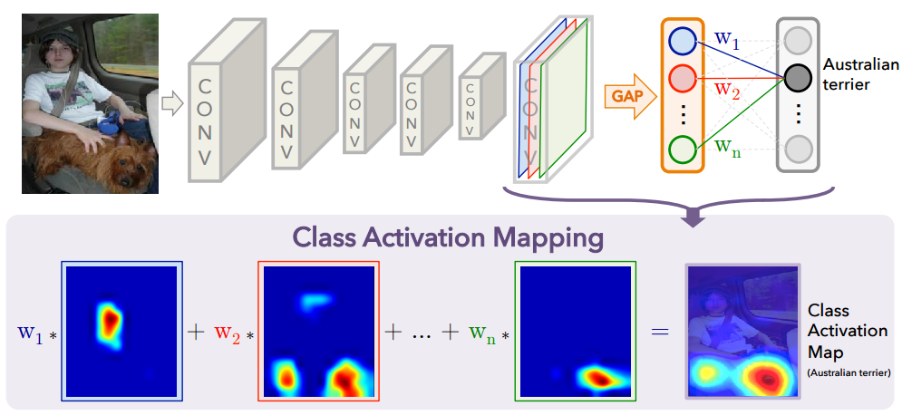
Deep Learning In Computer Vision
Learning Deep Features for Discriminative Localization

Slide 45
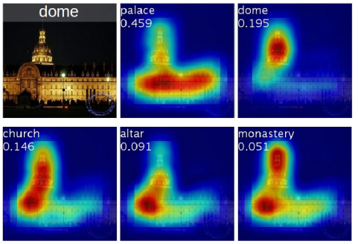
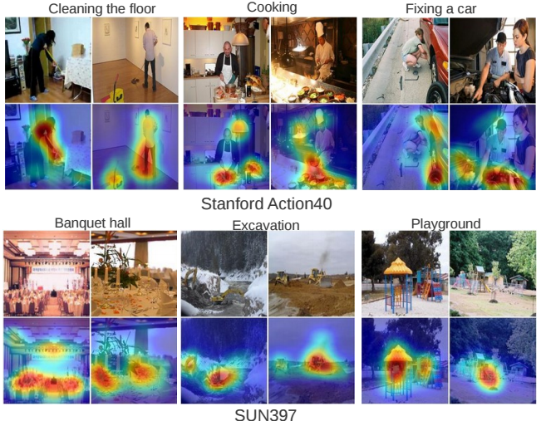
Deep Learning In Computer Vision
Learning Deep Features for Discriminative Localization

Slide 46
Conclusion
Section 05

Slide 47
Conclusion
Resurrection of Neural Network
Reason
New algorithm
New hardware
New data
Breakthrough at performance
Semi-supervised scheme
Further…
This seminar is a tiny starting point of deep learning
Plenty of variation exists
Removing the effect of noise
Speed up
Deep learning still have many open questions
Cannot model a causal (logical) relationship
Have many implementation issues

Slide 48
Reference
Sites
Deep learning community
http://deeplearning.net/
Deep learning documentation
http://deeplearning.net/tutorial/contents.html
Deep learning summer school (@UCLA, 2012)
https://www.ipam.ucla.edu/schedule.aspx?pc=gss2012
Clips are available
Deep learning에 대한 주변적 이야기
http://factorizer.egloos.com/879252
Documents
Learning Deep Architectures for AI (Yoshua Bengio, 2009)
Representation Learning: A Review and New Perspectives (Yoshua Bengio, 2012)
홉필드 네트워크
http://www.aistudy.com/neural/hopfield_kim.htm
Distributed representation
http://ai.ato.ms/MITECS/Entry/van_gelder1.html
위키피디아(Deep learning)
http://en.wikipedia.org/wiki/Deep_learning
News
Deep learning comes of age
http://cacm.acm.org/magazines/2013/6/164601-deep-learning-comes-of-age/fulltext

